Slide 1
HUOnG NOI’s members
No | Name | ID | Task
1 | Nguyen Tan Kiet | QE170003 | Construct + Present
2 | Bui Ngoc Bao Tran | QE170086 | Design slide + Present
3 | Tran Thu Ngan | QE170115 | Prepare script + Present
4 | Vu Ngoc Anh | QE170052 | In charge of “Conflict & negotiaion” part + Present
5 | Nguyen Hoang Anh Tuan | QE170044 | In charge of “Handling stress” part + Present

Slide 2



SSG104
NOV 2022
HUONG NOI
Chapter 14 & 15
CHAPTER 14 & 15
HUONG NOI

Slide 3
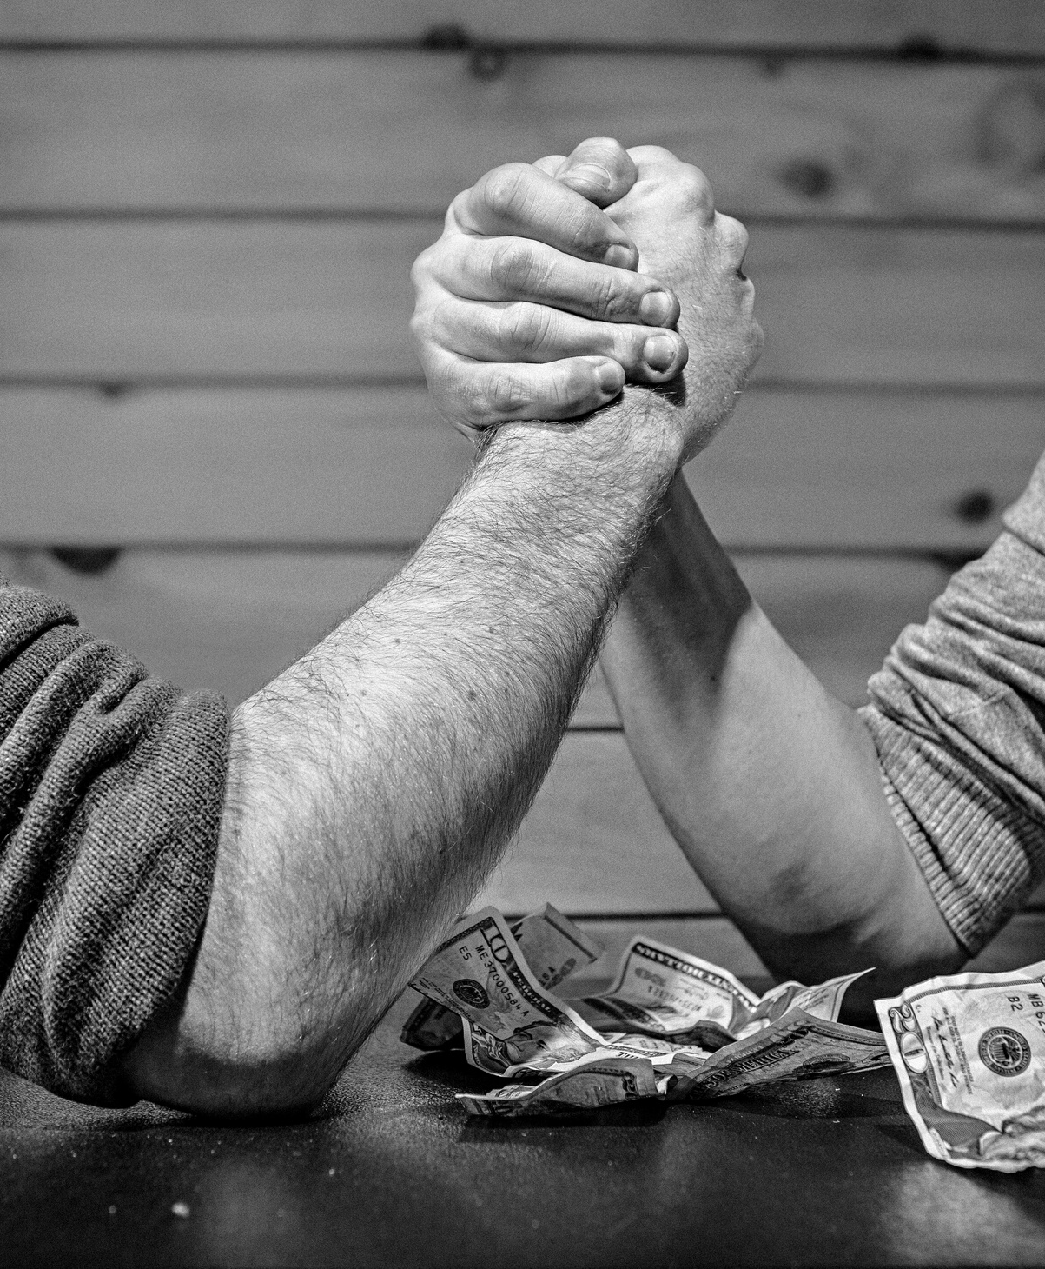
Table of content
HUONG NOI
  1. Conflict and negotiation
SSG104
2. Handling stress in a group

Slide 4


Conflict and negotiation
HUONG NOI

Slide 5
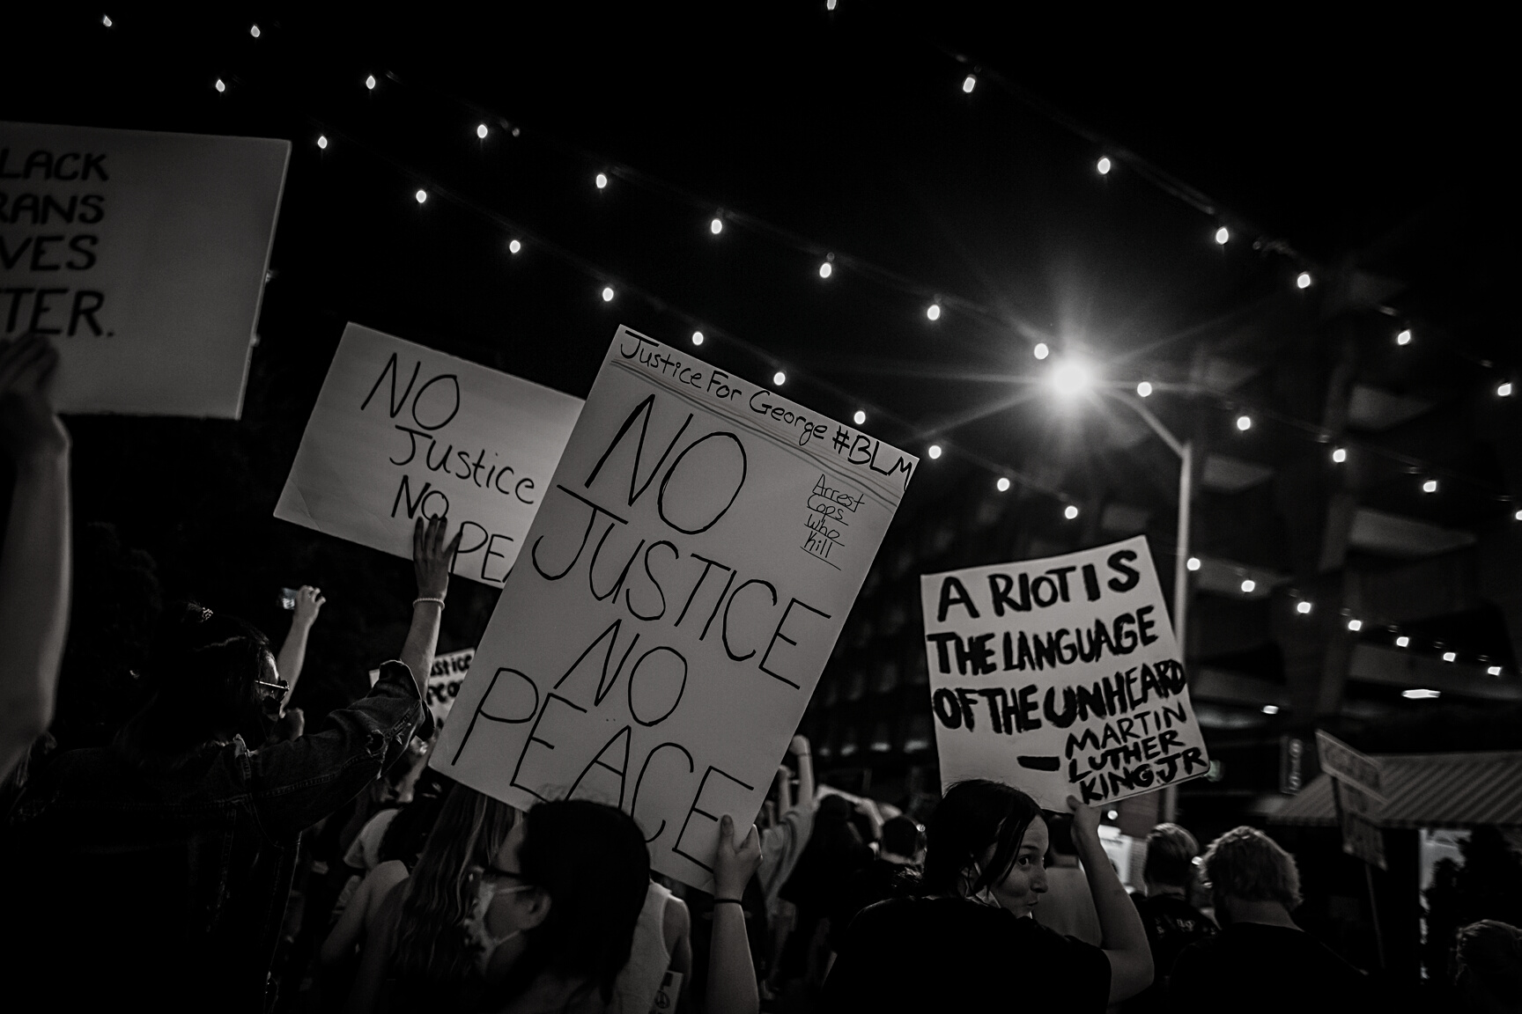
DEFINITION
The disagreement and disharmony that occurs in groups when differences are expressed regarding ideas, methods, and / or members.
Conflict has been defined by researchers Hocker and Wilmot as: “An expressed struggle between a least two interdependent parties who perceive incompatible goals, scare rewards and interference from the other party in achieving their goals.

Slide 6

DEFINITION
Negotiation - a process that occurs when two or more parties decide how to allocate scarce resources.

Slide 7


Group members express disagreement in a way that values everyone’s contribution and promotes the groups’ goal.
+ Respect others
+ Focus on issues
Constructive conflict
Group members scare hosstility and prevent achievement of the group ‘s goal.
+ Insult others
+ Inflexible and uncooperative
Destructive confflict

Slide 8



TASK
RELATIONSHIP
PROCESS

Slide 9


Conflict process
Stage I: Potential Opposition or Incompatibility
Stage II: Cognition and Personalization
Stage III: Intentions
Stage IV: Behavior
Stage V: Outcomes

Slide 10
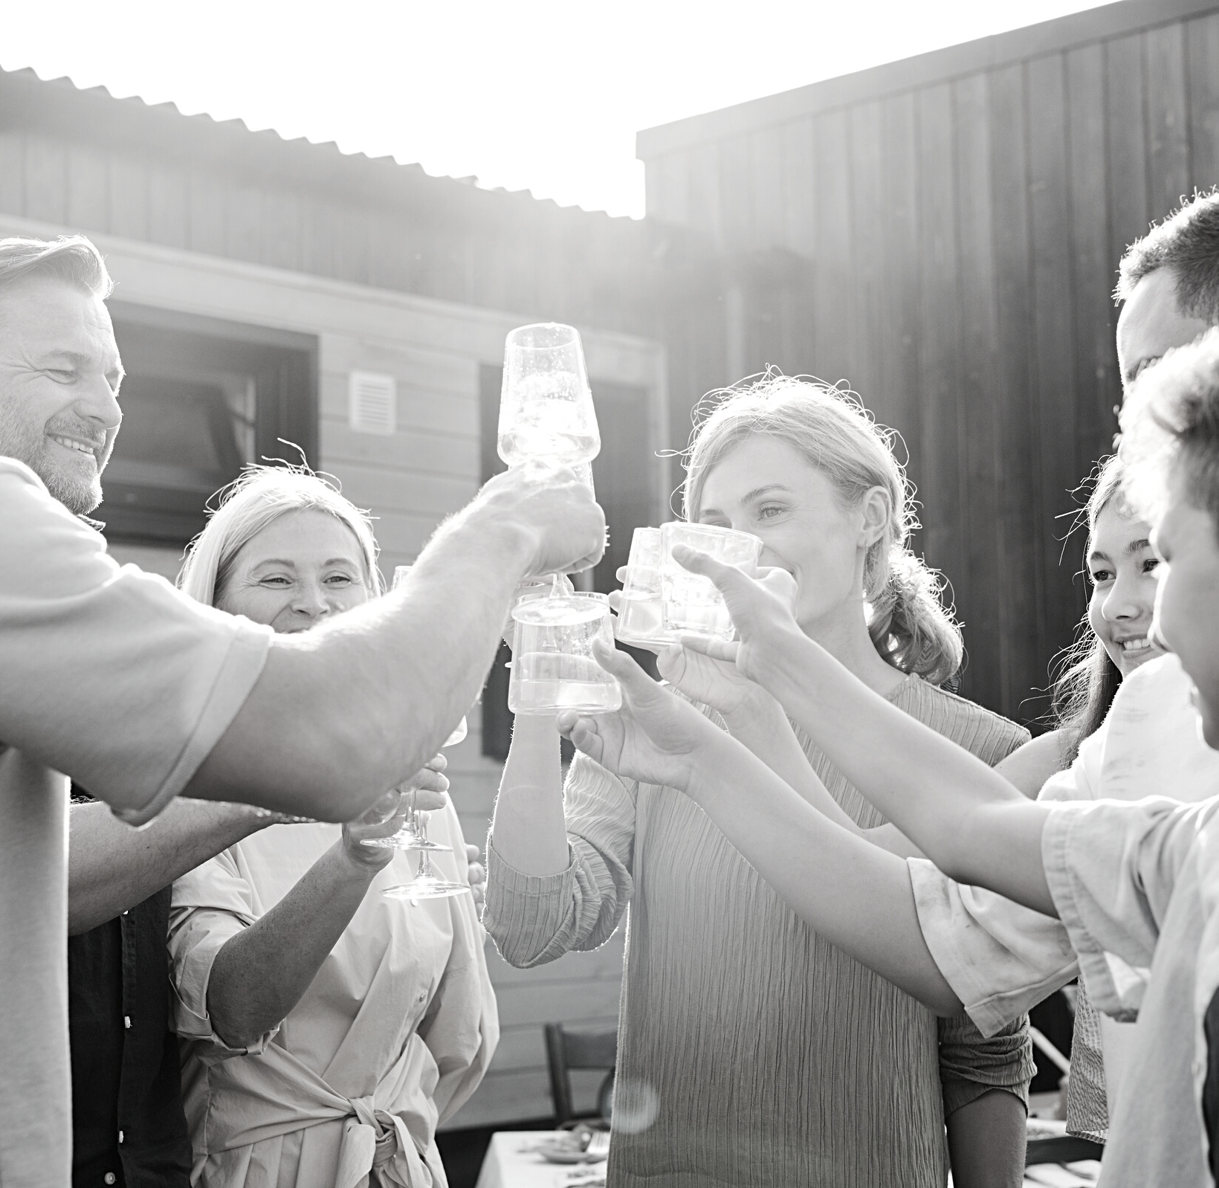
NEGOTIATION process
  Preparation and planning
  Definition of ground rules
  Clarification and justification
  Bargaining and problem solving
  Closure and implementation

Slide 11
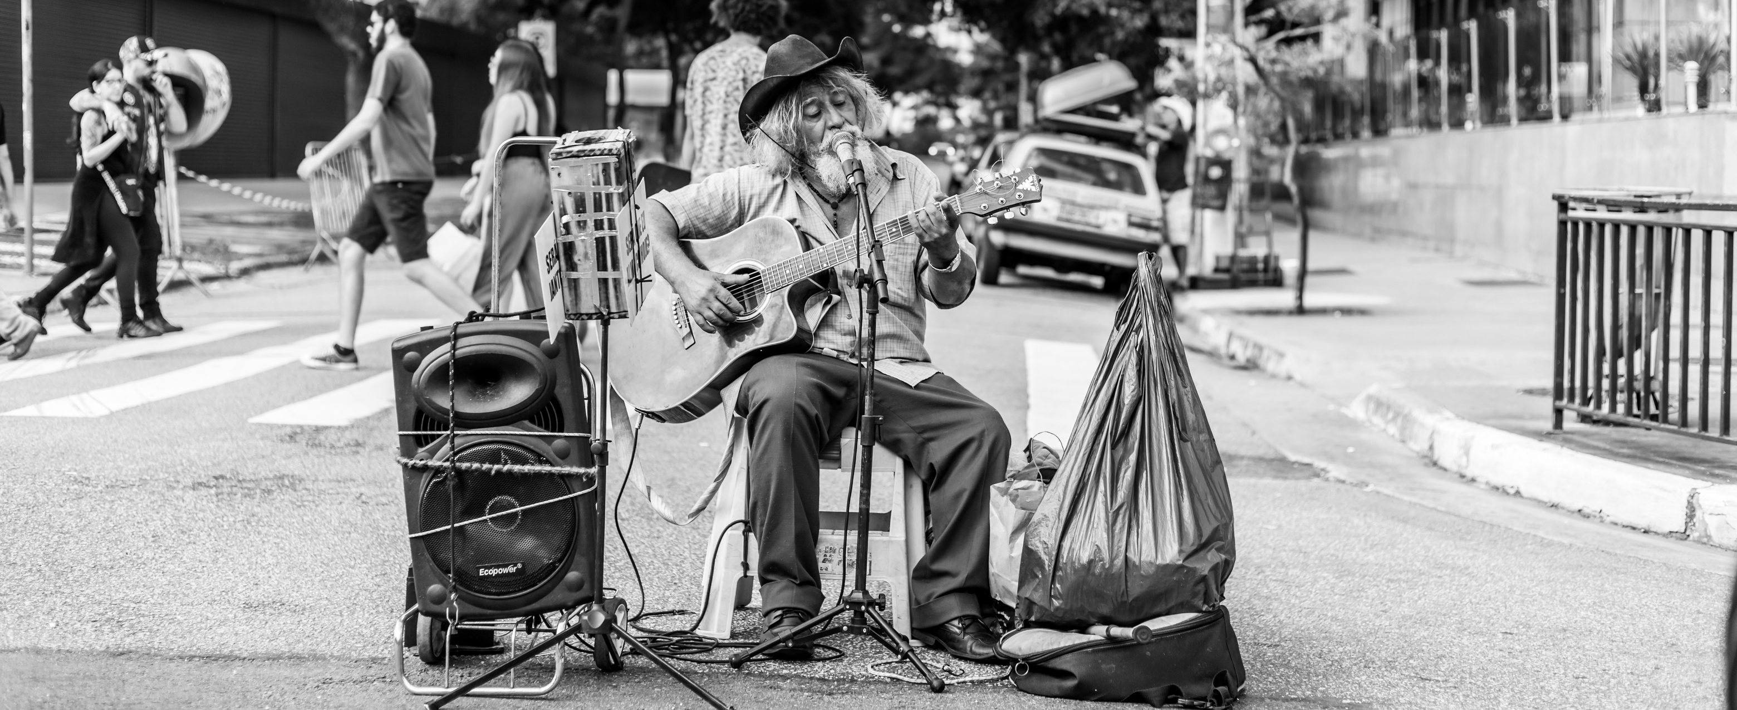
Individual Differences in Negotiation
  Personality Traits in Negotiations
  Moods/Emotions in Negotiations
  Culture in Negotiations
  Gender Differences in Negotiation
  Negotiating in a Social Context
  Reputation
  Relationships
  Third-Party Negotiations

Slide 12

Managing Functional Conflict
Functional
Dysfunction

Slide 13
  Emphasizing group goals and effectiveness.
  Providing stable, well-structured tasks.
  Facilitating dialogue.
  Avoiding win-lose situations.
PREVENTING

Slide 14


Handling stress in a group
HUONG NOI

Slide 15

HOW TO hANDLING
Stress
IN GROUP
  Maintain Transparency.
  Be Respectful and Friendly.
  Encourage Everyone to Get Sufficient Sleep.
  Have Realistic Expectations.
  Encourage Two-Way Communications.
  Don’t Impose Severe Consequences for Failure.

Slide 16

SSG104
THANK YOU
HUONG NOI

